Slide 1
SP 2013 to SPO
Migration Feasibility Check & strategy
Monday, July 14, 2025, By EA Team

Slide 2
Agenda
SP 2013 Inventory Summary, Migration Approaches, Strategy & Tools
Migration from SP 2013 to SPO – Types, Pros & Cons
Upgrade from SP 2013 to SPSE – Pros & Cons
Challenges & Solutions
Next Steps

Slide 3
SP 2013 Inventory Summary, Migration Approaches, Strategy & Tools
SP 2013 Inventory Summary:
Key Considerations for Upgrading to Higher Version (SPO, SE):
Application Type | Total#
Web applications | 2
Site collections | 33 in eshare; 2 in eportal
Subsites | 339 in eshare; 16 in eportal
Content dBs | 15 in eshare; 1 in eportal
DB size | Approx. 500 GB for eshare; 50 GB for eportal
Large lists (>5K records) | 15 in eshare; 0 in eportal
Custom forms (InfoPath, Nintex) | 8 in eshare; 0 in eportal
Custom Webparts | 8 in eshare; 11 in eportal
Custom masterpages/megamenu/footer/themes/branding | 1 in eportal; 3 in eshare
Custom Page layouts | 15 in eportal; 0 in eshare
SP Designer Workflows | 1 in eportal; 0 in eshare
Nintex Workflows | 0 in eportal; 3 in eshare
  SP 2013 MS support already expired and for SP2016, SP2019 extended support will expire in Jul 2026
  Exploring High availability with low maintenance
  Scalable and integrate with cutting edge technologies like M365
  Retain existing structure, look & feel to the extent permitted
  Utilize advanced low/No code technologies to minimize development times & efforts
Upgrade Options
  SP Online
  SP SE
  Hybrid (Site Core/SPSE & SP Online)
Migration Approaches, Strategy & Tools
  SP 2013 to SPO: using Migration Tools like Share Gate, Quest. Big Bang/Phased strategy based on feasibility, compatibility, timelines, resources availability.
    Classic to Classic: SharePoint 2013 → SharePoint Online
    Classic to Modern: SharePoint 2013 → SharePoint Online
  SP 2013 to SPSE (DB detach/ attach method): using multi server upgrade process. Big Bang/Phased strategy based on feasibility, compatibility, timelines, resources availability.
    SharePoint 2013 → SharePoint 2016 → SharePoint 2019 → SharePoint SE
  Hybrid (Partnership4Me to Site Core/SPSE, Eshare to SPO): Combination of above listed approaches, strategies. Use vendor recommended approaches & tools for Site core upgrade & Migration.

Slide 4
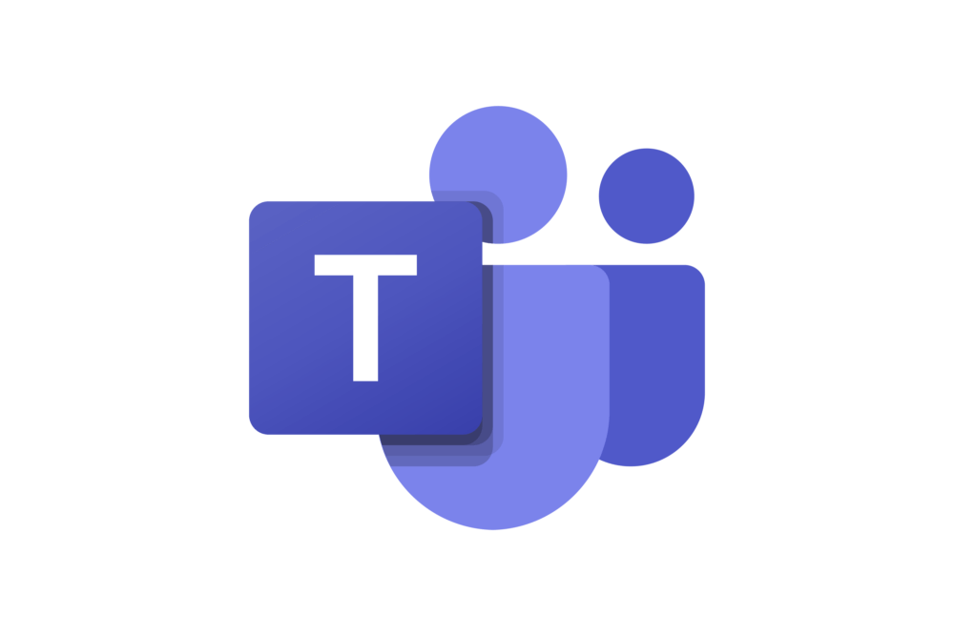
Migration from SP 2013 to SPO – Types
Classic to Classic
  Not feasible to directly utilize all advanced modern features & integrations.
  Risk of anytime MS can stop supporting classic sites.
  Need of vendor support & expertise resources to overcome challenges during migration.
  Minimal efforts compared to C2M with relatively similar look & feel on both eshare, eportal sites.
Classic to Modern (approx. 3x efforts compared to C2C)
  Significant shift in Look & feel for eshare sites.
  Steep learning curve for End Users.
  Need of vendor support & expertise resources to overcome challenges during migration.
  Can utilize and integrate with modern features & integrations.
PHC O365 Tenant
SharePoint 2013 On Premise
SharePoint Migration Tool

Slide 5
Migration from SP 2013 to SPO – Pros & Cons
PROS | Cons
Migrating to SPO offers significant benefits in terms of cost, security, accessibility, performance, and long-term sustainability Scalability & High Availability, Low Infra & Continue MS support & New Features Improved Security & Compliance: SSL, MFA, Data Loss Prevention (DLP) Policies, Anywhere access Integration with Microsoft 365 Tools, Modern User Experience & Customizations using SPFx Advanced Search & Analytics Migration Tools provide built-in pre-migration reports to identify customizations, permissions, large lists, checkout files & allows to update hard coded links within documents and pages during migration. | Limited flexibility for Classic to Modern Conversion. Limited modern features in classic mode Repairing Browser Bookmarks at each client side is unachievable. As Current hierarchy with various levels of subsites at both eshare & eportal sites makes it unfeasible to update Bookmarked links on Browser level. Page Approval workflow history can’t be retained. Redevelop all Custom webparts using SPFx. Troubleshoot unforeseen issues with Nintex forms and workflows in Nintex cloud. Challenging to retain search metadata. Meticulous Governance policies at Tenant level required as there is possibility of sharing or misusing PHI / PII data as it’s a cloud-based application. Performance Limitations while doing migration using Migration Tools.

Slide 6
Upgrade from SP 2013 to SPSE
We are obligated to install each version of SP, attach content databases, and upgrade them successively
Assessment & Planning:
Pre Migration Maintenance
Identify deprecated features
For each upgrade hop (e.g., 2013 → 2016 → 2019 → SPSE):
  Build target farm (SP 2016/2019/SE) matching the source topology (as closely as needed).
  Create and Configure Web Applications and Service Applications.
  Detach, Attach and Mount/Upgrade the content database from the old SP farm to new SP farm till last SPSE upgrade hop.
We don’t have direct migration path to SPSE using DB upgrade method.
SharePoint 2013 On Premise
SharePoint 2016 On Premise
SharePoint 2019 On Premise
SPSE Version On Premise
Recommended Migration Path from SP 2013 To SPSE version
Notes:
Before upgrading, make sure SP 2013 servers are updated with latest patches / CUs & same for SPSE servers
Validate & ensure custom solutions (WSPs), Content DBs, master pages, themes, Nintex forms & workflows, InfoPath forms, SPD workflows, and web parts are compatible or have alternatives

Slide 7
Upgrade from SP 2013 to SPSE
PROS | Cons
Bookmarked hardcoded links at client-side browser are under our control. Frequent MS patch releases and support Precise look & feel Safeguarded with Intranet Firewalls even if user stores PHI/PII data Supports modern UI and hybrid setup to integrate with M365 Minimal Vendor costs & Free of Migration Tool licensing costs | Active maintenance of infra/server by upgrading CU/security patches on monthly basis. Down Time during Maintenance hours Dependency on ITOPS/Kemp vendor with server/Kemp issues Need to setup intermediate hop versions & additional SP licensing costs for each hop version. Technological backwardness Time-consuming: we need to build and maintain temporary farms for each version. Cumulative complexity: Issues can compound across versions. InfoPath and Designer workflows are deprecated. Partnership VPN or intranet network connectivity is required to access sites.

Slide 8
Upgrade from SP 2013 to SPSE
Challenges | Solutions
SPO C2M : Significant Look & Feel differences Browser bookmarked links Workflow History Loss Nintex Forms, Flows SPO C2C Bookmarked links Workflow History Loss Nintex Forms, Flows SPSC Downtimes, Server Maintenance | SPO C2M : User Training Materials Communications & Trainings Make sure no pending instances in source & execute PowerShell script to migrate workflow history. Replace unsupported actions with Nintex Cloud Actions or reimplement solution in Power Platform. SPO C2C Communications & Trainings Make sure no pending instances in Source & execute PowerShell script to migrate workflow history. Replace unsupported actions with Nintex Cloud Actions or reimplement solution in Power Platform. SPSC Active Maintenance

Slide 9
Key Pros & Cons of Migrating to SPO, SPSE
SP Online Cloud
SPSE On Premise
Hybrid – SPO & SPSE/Site Core SiteCore
PROS
Scalability & High Availability, Low Infra & Maintenance Costs
Improved Security & Compliance
  Default SSL, Multi-factor authentication (MFA), Data Loss Prevention (DLP) policies
  Easier compliance with global standards (GDPR, HIPAA, etc.)
M365 Integration & Modern User Experience
Advanced Search & Analytics
PROS
Bookmarked hardcoded links at client-side browser are under our control
Frequent MS patch releases and support
We can retain eportal , eshare site urls names as-is and can be accessed with HTTPS.
Precise look & feel
Safeguarded with Intranet Firewalls even if user stores PHI/PII data
Supports modern UI and hybrid setup to integrate with M365
Minimal Vendor costs & Free of Migration Tool licensing costs
CONS:
Not suggestable to maintain 2 separate platforms as these 2 sites are internconnected and exchanging / interacting data.
Hybrid – SPO & SPSE Increases complexity by combining all PROS & CONS of above 2 approaches( SPO, SPSE)
Hybrid – SPO & Site Core requires Substantial amount of additional efforts, costs, timelines and skillset.
CONS
Limited flexibility for Classic to Modern Conversion
Third-party Customizations
  Custom-developed features, functionalities or third-party solutions in SharePoint 2013 will not migrate & require manual redevelopment / re-implementation.
  Custom webparts, master pages, CSS, pages & page layouts, JS injected webparts, content editor and script editor webparts, InfoPath forms and any custom forms needs to be redesigned in Power Platform or using SPFx
No Workflow Migration
  Workflow history won't migrate to SPO
  Running workflow instances should close before migration and re-initiate in the newer environment.
CONS
Active maintenance of infra/server by upgrading CU/security patches on monthly basis.
Down Time during Maintenance hours
Dependency on ITOPS/Kemp vendor with IIS/Kemp issues
Need to setup intermediate hop versions & additional SP licensing costs for each hop version.
Technological backwardness
Time-consuming: we need to build and maintain temporary farms for each version.
Cumulative complexity: Issues can compound across versions.
InfoPath and Designer workflows are deprecated; consider alternatives.
Partnership VPN or intranet network connectivity is required to access sites.

Slide 10
Next Steps
Decide the right upgrade option. Before deciding, it would be better to involve Improvement vendor & Migration Tools (Sharegate/Quest) team for an assessment.
    Improvement for redevelopment of Partnership4Me (Web parts in Landing Page, Mega Menu, Footer, Workflow)
    Sharegate/Quest for unforeseen migration challenges/questions
        Setting up an example for Partnership4MeUAT migration, 1 Department site, & 2 Product sites
Setup, Procure Infra & licenses according to migration approach
If required, validate with Sitecore, Nintex, MS & 3rd party vendors for their product support & procure licenses accordingly
Upskill team’s skillset
Conduct End user trainings and prepare Training meterials.

